Slide 1
Elastic-recheck For Openstack
Logstash +Elasticsearch+Kibana
Notes:
日志监控和分析在保障openstack业务稳定运行时，起到了很重要的作用。不过一般情况下日志都分散在各个生产服务器，且开发人员无法登陆生产服务器，这时候就需要一个集中式的日志收集装置，对日志中的关键字进行监控，触发异常时进行报警，并且开发人员能够查看相关日志。logstash+elasticsearch+kibana就是实现这样功能的一套系统，并且功能更强大。

Slide 2
Agenda
History
Workflow
Examples

Slide 3
History
Elastic-recheck: use ElasticSearch to classify OpenStack gate failures
A more automated solution, using Elasticsearch to address many of the issues with the manual process so that developers could be automatically notified if their change hit a known bug.
In 2013, Clark began implementing an Elasticsearch + Logstash + Kibana (the ELK stack) solution for the OpenStack infrastructure.
Over that summer, Sean created some sample code to talk to the web service. Joe Gordon and Matthew Treinish then turned the sample code into elastic-recheck in September of 2013, when stress on the project infrastructure hit a high point and manual rechecks were common.

Slide 4
Agenda
History
Workflow
ELK Stack
Elastic-recheck
Examples

Slide 5
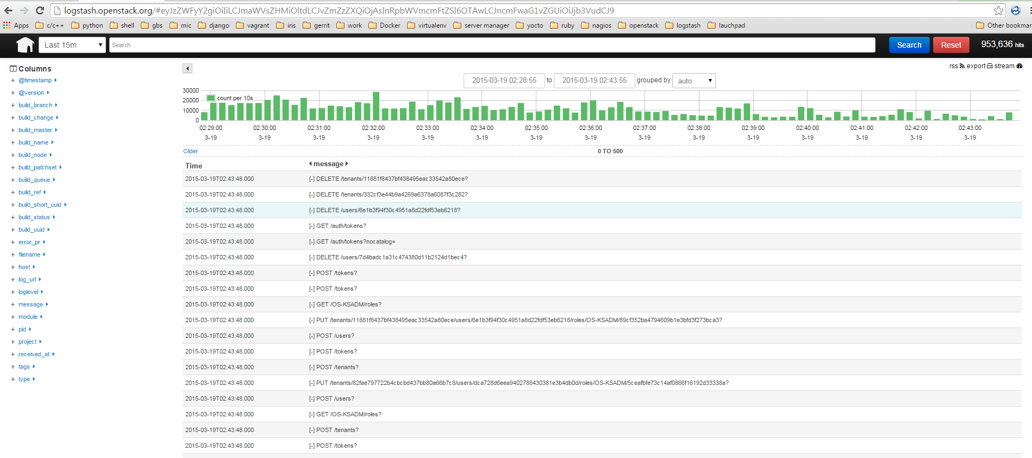
ELK Stack (Elasticsearch+Logstash+Kibana)
Notes:
http://logstash.openstack.org
Loastash+elasticsearch+kibana 为openstack工程搭建的log平台

Slide 6
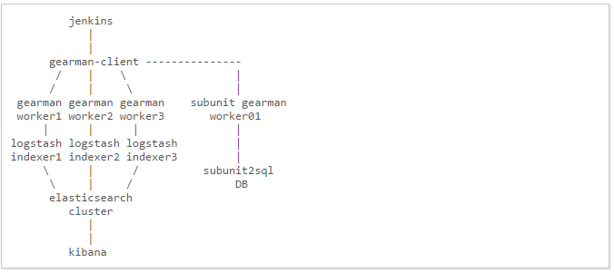
ELK Setup For Openstack
Notes:
There are four major layers in our Logstash setup.
Log Pusher Scripts. Subscribes to the Jenkins ZeroMQ Event Publisher listening for build finished events. When a build finishes an event is received from Jenkins which is then converted into Gearman jobs specific to that event for each log file we care about. These jobs trigger Gearman workers that then fetch the logs generated by that build, chop them up, annotate them with Jenkins build info and finally sends them to a Logstash indexer process.
Logstash Indexer. Reads these log events from the log pusher, filters them to remove unwanted lines, collapses multiline events together, and parses useful information out of the events before shipping them to ElasticSearch for storage and indexing.
ElasticSearch. Provides log storage, indexing, and search.
Kibana. A Logstash oriented web client for ElasticSearch. You can perform queries on your Logstash logs in ElasticSearch through Kibana using the Lucene query language.

Slide 7
Agenda
History
Workflow
ELK Stack
Elastic-recheck
Examples

Slide 8
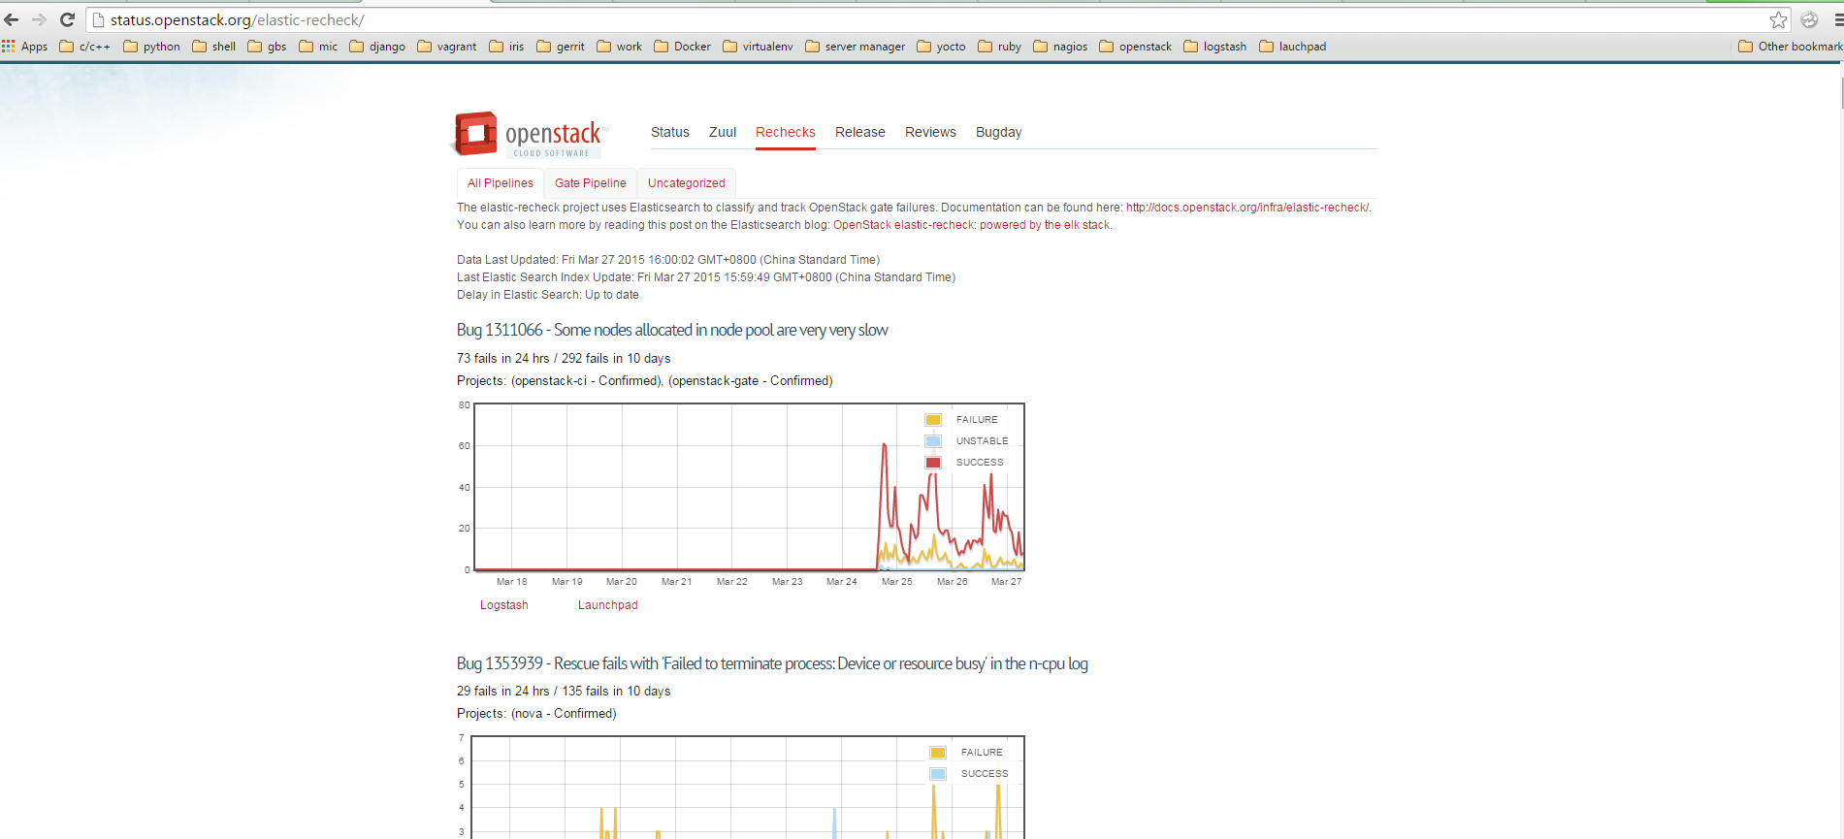
Elastic-recheck
Notes:
http://status.openstack.org/elastic-recheck/

Slide 9
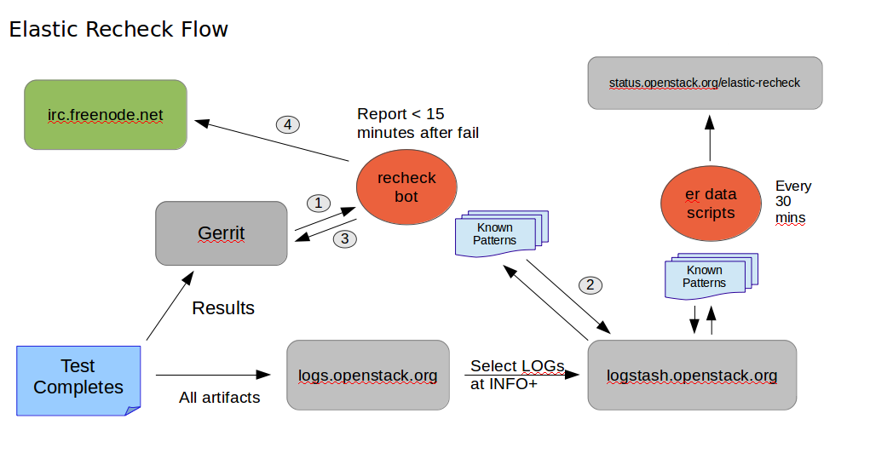
Elastic-recheck Flow

Slide 10
Agenda
History
Workflow
Examples
Creating bug 1349617 in Elastic-rechek
Automatic responses for a Gerrit patch

Slide 11
Creating Bug 1349617 in Elastic-recheck
Find a log that is associated with the failure.
“SSHException: Error reading SSH protocol banner[Errno 104] Connection reset by peer .”
Go to logstash.openstack.org and create an elastic search query to find the log message from step 1.
message:"Failed to establish authenticated ssh connection to cirros@" AND message:"(Error reading SSH protocol banner[Errno 104] Connection reset by peer). Number attempts: 18. Retry after 19 seconds." AND tags:"console"

Slide 12
Creating Bug 1349617 in Elastic-recheck
Create a bug in our bug tracker for the error, add a comment to the bug with the exact query identified via Kibana, and a link to the logstash url for that query search.
https://bugs.launchpad.net/neutron/+bug/1349617
Submit a simple YAML-based change to the elastic-recheck repository's queries/ directory, which contains the list of bugs to track.
https://git.openstack.org/cgit/openstack-infra/elastic-recheck/tree/queries.

Slide 13
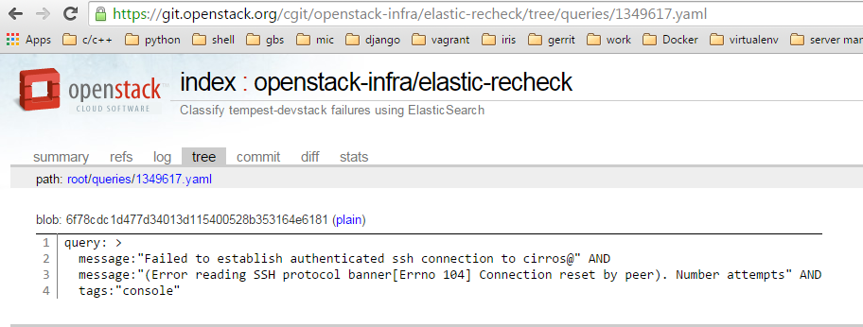
Creating Bug 1349617 in Elastic-recheck

Slide 14
Creating Bug 1349617 in Elastic-recheck
A bug in elastic-recheck will be created after patch is merged.
http://status.openstack.org/elastic-recheck/#1349617
An aggregation of all failed gate jobs that don’t currently have elastic-recheck fingerprints:
http://status.openstack.org/elastic-recheck/data/uncategorized.html

Slide 15
Agenda
History
Workflow
Examples
Creating bug 1349617 in Elastic-rechek
Automatic responses for a Gerrit patch

Slide 16
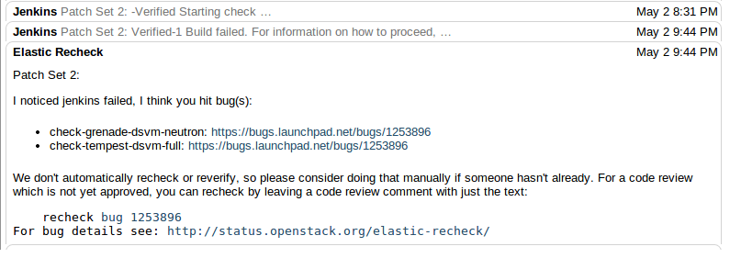
Automatic Responses for A Gerrit Patch

Slide 17
References
ELK Stack:
https://www.elastic.co/
Elastic-recheck Code:
http://git.openstack.org/cgit/openstack-infra/elastic-recheck/tree/
Elastic-recheck Documentation:
http://docs.openstack.org/infra/elastic-recheck/
https://www.elastic.co/blog/openstack-elastic-recheck-powered-elk-stack/

Slide 18


